Slide 1
Image Captioning
Deepika Kolli
Sruthi Reddy
Ankit BVS

Slide 2
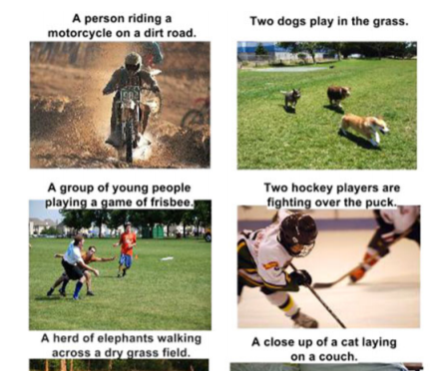
Objective
Data Preparation
Models
Metrics & Results
Generating captions for an image.

Slide 3
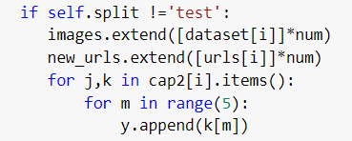

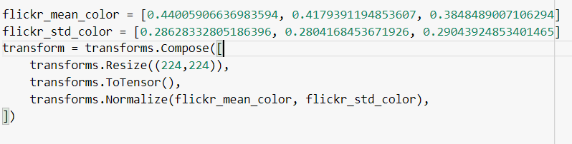
Data Preparation
Image 1
Caption 1, Caption 2, Caption 3, Caption 4, Caption 5
Flickr 8k Dataset
Image 1
Caption 1
Image 1
Caption 2
Image 1
Caption 3
Image 1
Caption 4
Image 1
Caption 5
Transformation of images
Train (6000)
Validation
(1000)
Test
(1000)

Slide 4
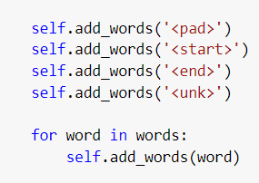
Vocabulary building
Split caption text into words and trim any trailing whitespaces. Converted to lowercase.
Since the vocabulary size affects the embedding layer dimensions, Removed any words which appear 3 times or less. Final vocab size= 2933
Added Special tokens like <pad>, <start> , <end>, <unk> to the vocabulary

Slide 5
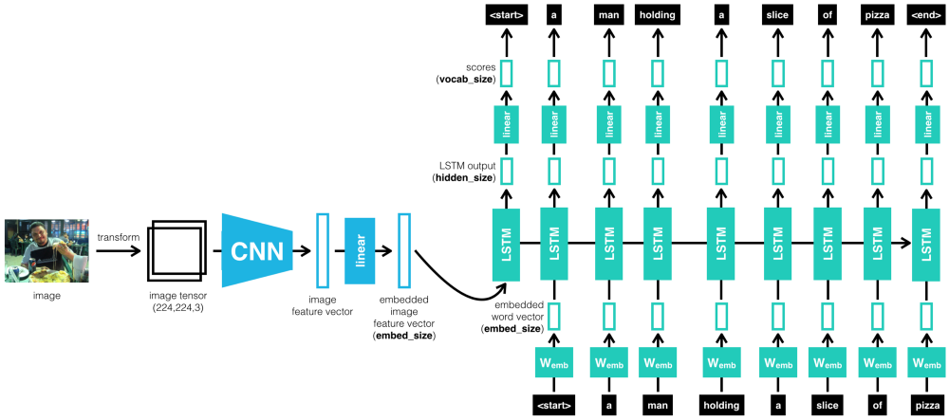
Models
ENCODER CNN
DECODER LSTM
Notes:
Image source: https://miro.medium.com/max/1000/1*ERwScS7k6IH3hZIJmGdHDg.png

Slide 6
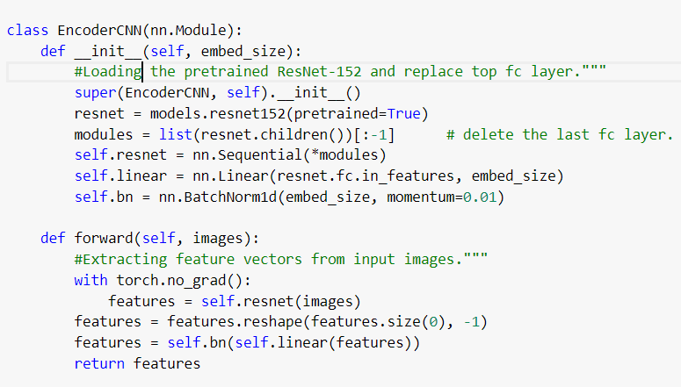
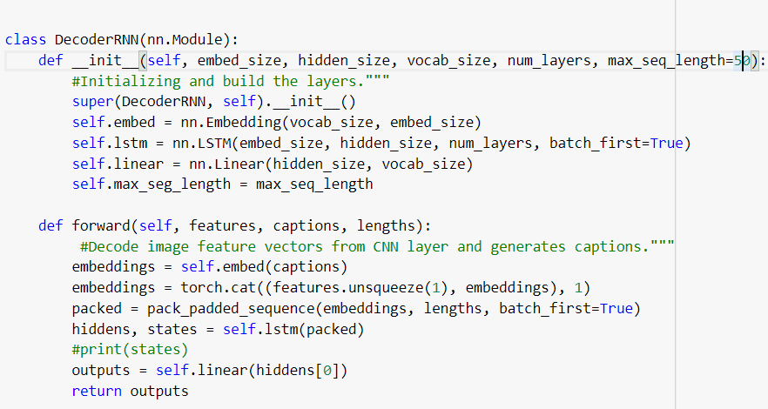
ENCODER-CNN
DECODER-LSTM
Dimensions at each layer:
Input – 32,3,224,224
After resnet-32,2048
After Linear-32,256
After Bn- 32,256
Best Parameters:
Batch Size – 32
Embed size- 256
Learning rate- 0.0001
Dimensions at each layer:
Input – 32,256
After embed-32, b ,256
Inputs to linear -c ,512
Outputs: 512, vocab size
Best Parameters:
Batch Size – 32
Embed size- 256
Hidden dimension- 512
Learning rate- 0.0001
b-max length of caption in batch, c-sum of all original lengths of captions in batch

Slide 7
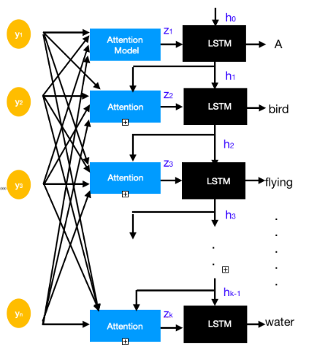
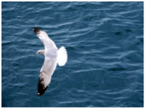
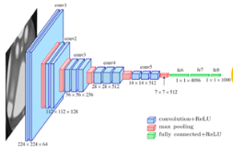
Attention Mechanism
https://medium.com/swlh/image-captioning-using-attention-mechanism-f3d7fc96eb0e

Slide 8
Encoder Attention
(Linear)
(B * 1 * 2048)
Combined Output
(B * 1)
Encoder Output
(B * 1 * 512)
Full Attention Output
*
Full Attention
(Linear)
Softmax
×
Decoder Attention
(Linear)
Softmax Output
(B * 1)
Attention Weighted Encoding
Attention wt. values
(B * 1 * 2048)
(B * 512)
Hidden state values
(B * 2048)
Encoder Output
LSTM
Attention Output + Embedded Captions + Hiddens + States
New Attention Weighted Encoding
Predictions
(B * 2048)
×
(B * 7708)
(B * 2048)
Sigmoid Gate
(Linear(Hiddens))
Hidden State Values

Slide 9
Encoder Attention
(Linear)
(B * 1 * 2048)
Combined Output
Encoder Output
(B * 1 * 512)
*
Full Attention
(Linear(Relu))
Full Attention Output
Softmax
×
Softmax Output
Decoder Attention
(Linear)
(B * 1)
(B * 1)
Attention Weighted Encoding
Encoder Output
(B * 512)
Attention wt. values
Hidden state values
×
(B * 2048)
(B * 1 * 2048)
Predicted Caption Vectors
States values
(B * 512)
LSTM
New Attention Weighted Encoding
Predictions
(Linear)
Attention Output + Hiddens + States
(B * 2048)
(B * 7708)
×
Hidden state
values
(B * 2048)
Sigmoid Gate
(Linear(Hiddens))
(B * 7708)
Hidden State Values
(B * 512)

Slide 10
Encoder Attention
(Linear)
(B * 1 * 2048)
Combined Output
Encoder Output
(B * 1 * 512)
*
Full Attention
(Linear(Relu))
Full Attention Output
Softmax
×
Softmax Output
Decoder Attention
(Linear)
(B * 1)
(B * 1)
Attention Weighted Encoding
Encoder Output
(B * 512)
Attention wt. values
Hidden state values
×
(B * 2048)
(B * 1 * 2048)
Predicted Caption Vectors
States values
(B * 512)
LSTM
New Attention Weighted Encoding
Predictions
(Linear)
Attention Output + Hiddens + States
(B * 2048)
(B * 7708)
×
Hidden state
values
(B * 2048)
Sigmoid Gate
(Linear(Hiddens))
Hidden State Values
(B * 512)

Slide 11
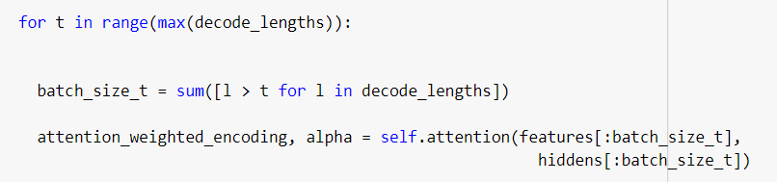
Attention Code Flow
Based on the maximum caption length we are using Attention Mechanism.
Attention Inputs :
Encoder output (B * 1 * 2048)
Hidden state values (B * 512)

Slide 12
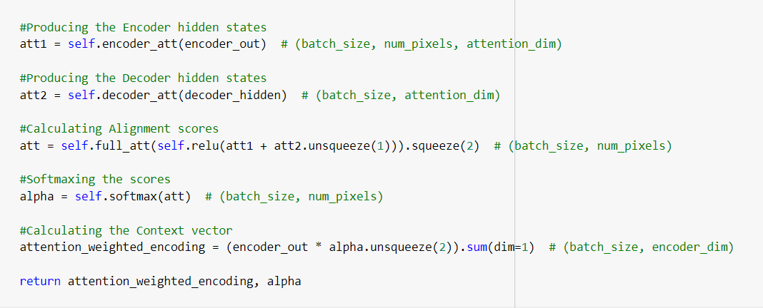
Attention Code Flow
Encoder Output is passed to Linear function to get the Encoder hidden State values
Decoder Output is passed to Linear function to get Decoder hidden states.
Scores are calculated based on the above values. High scores are given for the feature section on which we want to focus.
We are finding the probabilities of these scores using Softmax activation function.
We are calculated context vector by multiplying encoder output values and softmax output. High weightage is given to the part we want to focus on.

Slide 13
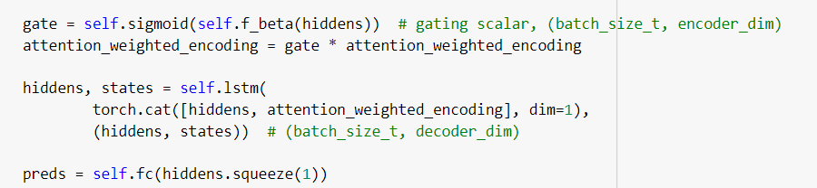
Attention Code Flow
We are using a sigmoid gate here to apply deeper attention to the image section. The hidden state values which we obtain from the LSTM are passed to gate to have deeper attention on the image features where we want to focus on.
New attention weighted encoding values are obtained from it which is passed to LSTM.
The hidden state values are passed to a Fully connected layer to obtain our predicted captions

Slide 14
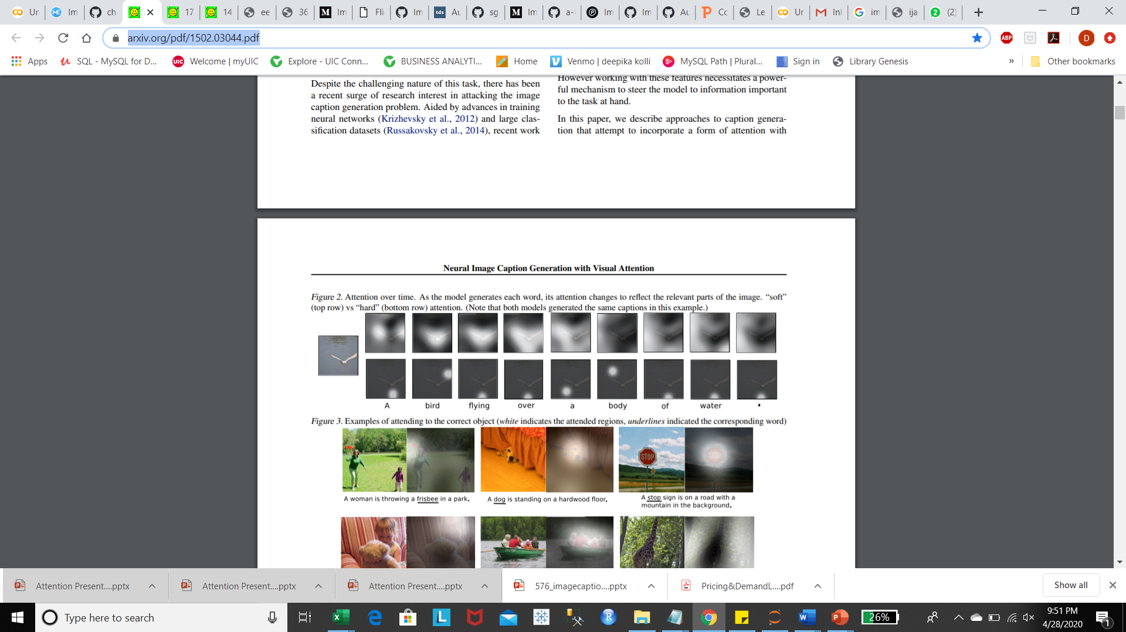
How does Attention work for image?
https://arxiv.org/pdf/1502.03044.pdf

Slide 15
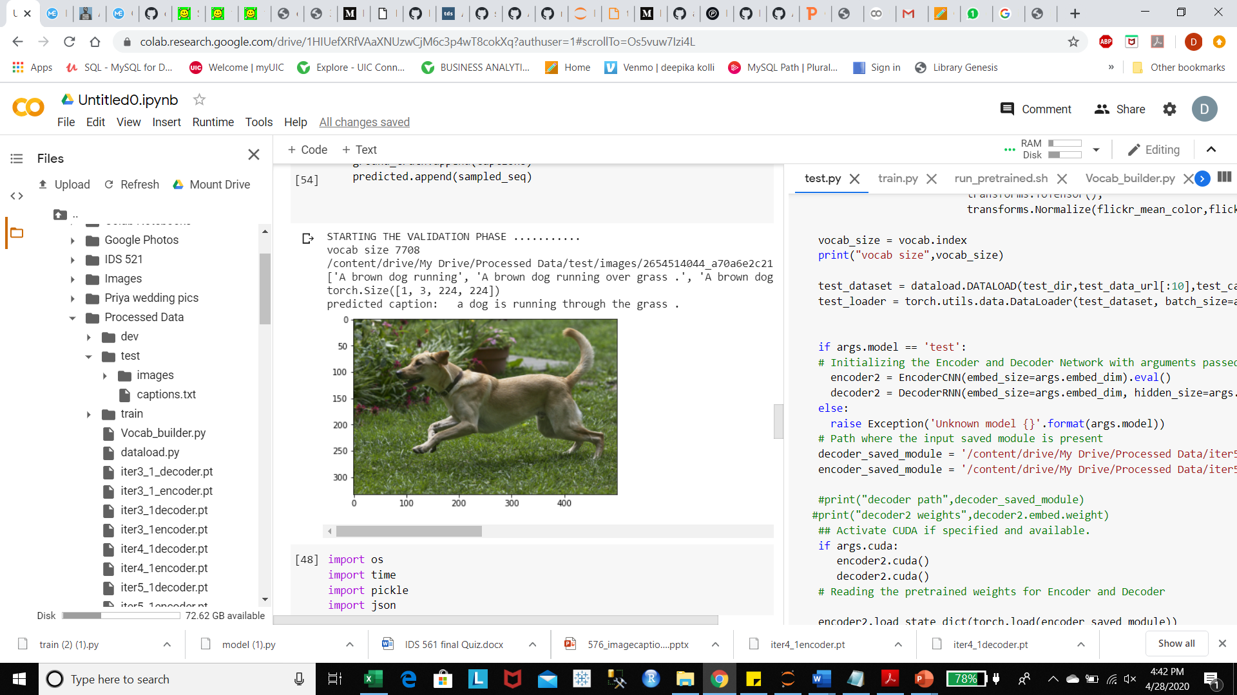
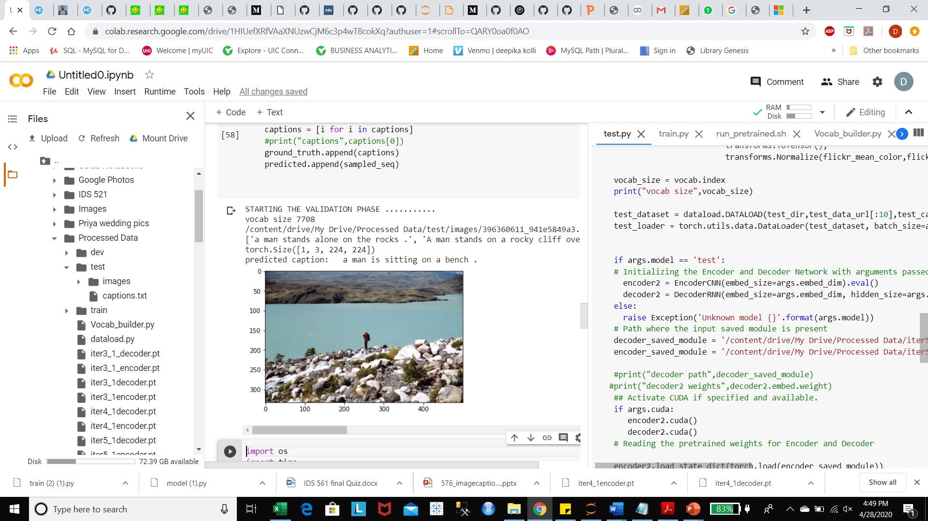
Results
 | Without Attention
Epoch | Train Avg_loss | Validation Avg_loss
0 | 8.763296 | 8.107386
1 | 3.67889 | 3.55854
 | With Attention
Epoch | Train Avg_loss | Validation Avg_loss
0 | 7.967365 | 8.053673
1 | 3.034889 | 2.977458

Slide 16
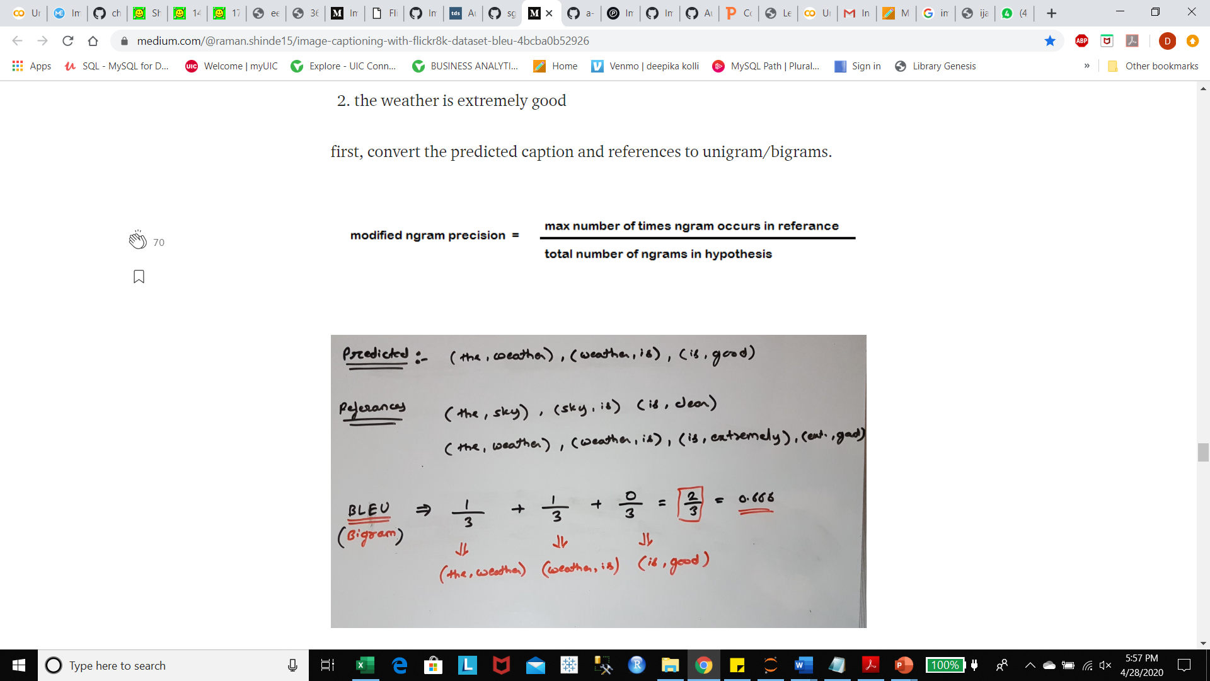
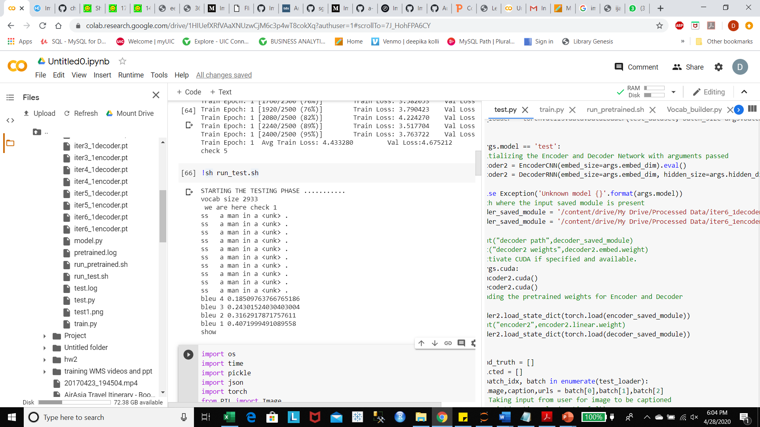
Evaluation Metric
The Bilingual Evaluation Understudy Score (BLEU) is a metric for evaluating a generated sentence to a reference sentence. A perfect match results in a score of 1 whereas a perfect mismatch results in a score of 0. It tells how good is our predicted caption as compare to the provided 5 reference captions.
We used a function called corpus_bleu() from NLTK package for calculating the BLEU score for the captions.
Calculation for BLEU
We evaluated the model using BLEU metrics on Test Data :

